Slide 1

My BYU Journey
Notes:
Jared starts

Slide 2


Sarah’s car is stuffed with bedding, snacks, and a lifetime of memories as she pulls into BYU for the first time. Her parents help her unload everything, her mom tucks a handwritten note in her bag, and her dad tries to fix the mini fridge’s wobbly leg.
Notes:
Picture Ideas: Packed car, little note in corner

Slide 3
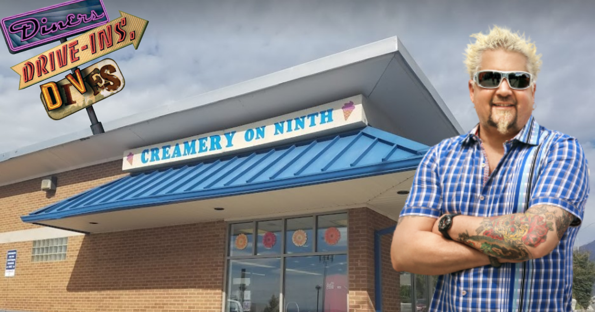

Her parents say goodbye over a dinner of burgers and fries and wish her luck at NSO the next day. Sarah's already received a text from her peer mentor and is excited to meet them.
Notes:
Picture: BYU Creamery

Slide 4
For the first time alone Sarah stands in the quiet of her new room, surrounded by the soft buzz of campus outside. She feels excited, but also a little scared. What’s expected of her now?
Expectations of First-Year Students

Slide 5
Expectations of First-Year Students
Show up: Be present—in class, in conversations, in opportunities.
Ask questions: No one expects you to know everything.
Try new things: This is your time to explore.
Take responsibility: You’re in charge of your learning, your time, your growth.
Use your resources: Mentors, professors, advisors—there’s a team ready to support you.
Continue the Story
Notes:
Micah

Slide 6
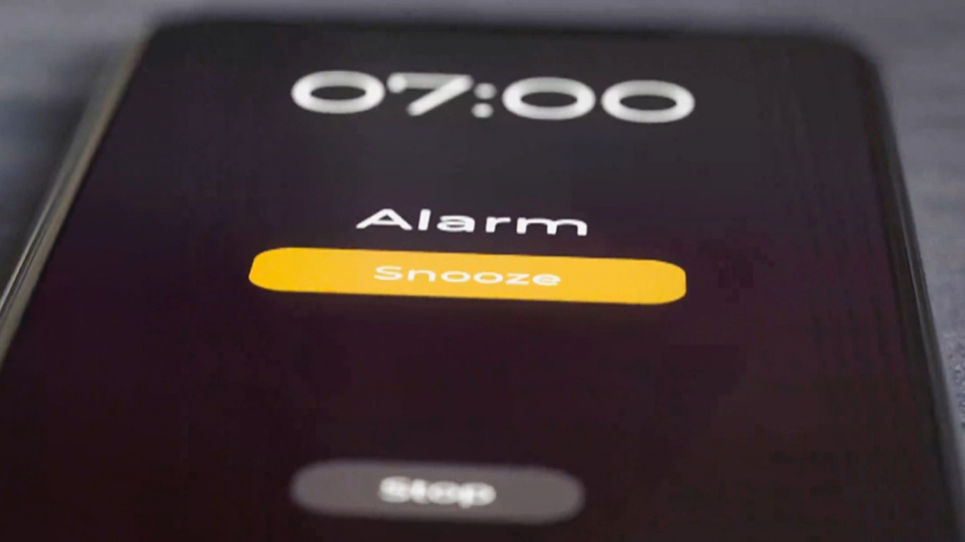
Monday morning, Sarah’s alarm goes off before the sun. She triple-checks her schedule and heads out, feeling both excited and totally lost.
Notes:
Picture: Alarm

Slide 7
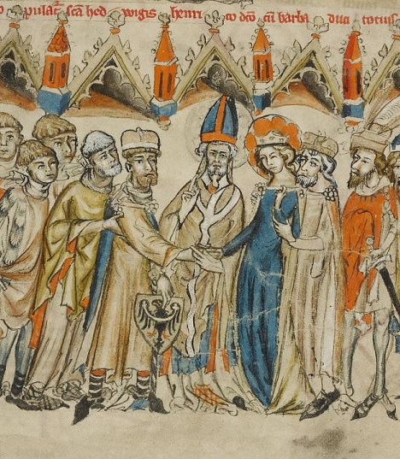
She walks into what she thinks is her English class—only to find herself in a huge lecture on medieval history. Oops. She laughs it off; cheeks flushed she slips out before the professor notices.
Notes:
Picture: A painting of Medieval history

Slide 8
Back outside, she texts her mentor: “I think I already failed day one.” Her mentor replies with a laughing emoji and says, “Don’t worry—it happens to everyone. Let me show you how to navigate campus.”
First-Year Mentoring

Slide 9
First-Year Mentoring
One-on-one support for adjusting to college life
Mentors who get it—they’ve been there too
Help with navigating campus, understanding classes, and asking for help
A safe place to say, “I don’t know where to start”
Continue the Story

Slide 10
Later that day, she finds her next class and stands outside the door. Should she sit near the front next to a friendly looking girl or hide in the back?
Notes:
Picture: making a choice clipart

Slide 11
Should Sarah sit near others or sit in the back?
Choice
Sit near others
Sit in the back

Slide 12

Sit Near Others
Sarah chooses the front. She slides into a seat and smiles nervously at the girl next to her. “Is this the class with the reading quiz?” she asks. They laugh and compare notes—instantly, Sarah feels a little less alone.
Continue the story

Slide 13

Sit in the Back
Sarah heads to the back and sits in an empty row-- but someone ends up sitting next to her anyway, asking for help finding the syllabus. They chat for a minute—turns out, she’s not the only one feeling lost.
Continue the story

Slide 14

By the third week, midterms loom. Sarah can't seem to stop thinking about how her roommates are always making plans to go dancing, all she can seem to do is stress about all of her midterms- she’s never been good at tests.
Notes:
Pictures: movie dance scene

Slide 15
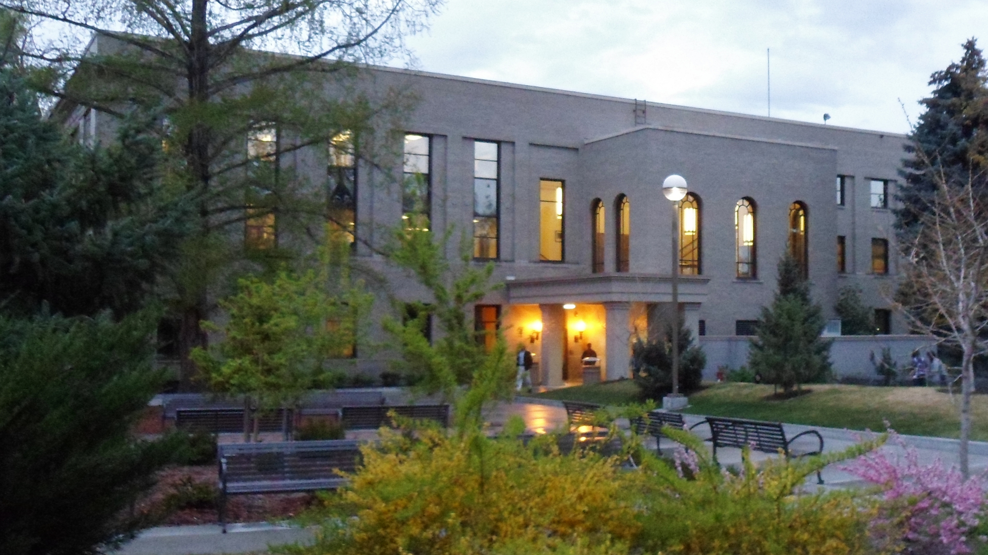
After rushing to the testing center on the last day to take her American Heritage test, she learns the hard way that there’s a $5 fee if you wait to take your exam until the last minute. It’s not much, but it’s enough to make her realize she needs a better plan.
Notes:
byu alternate universe covid testing center
Inner workings sad man at desk

Slide 16

Trying to do better, Sarah’s torn between joining the study group her friends keep talking about or heading to the TA lab—where she’s heard there’s always someone to offer one-on-one help, and maybe even a cute guy in the corner with his own flashcards.
Notes:
Flirting for dummies book

Slide 17
Should Sarah go to her study group or go to the TA lab?
Choice
Study group
TA lab

Slide 18
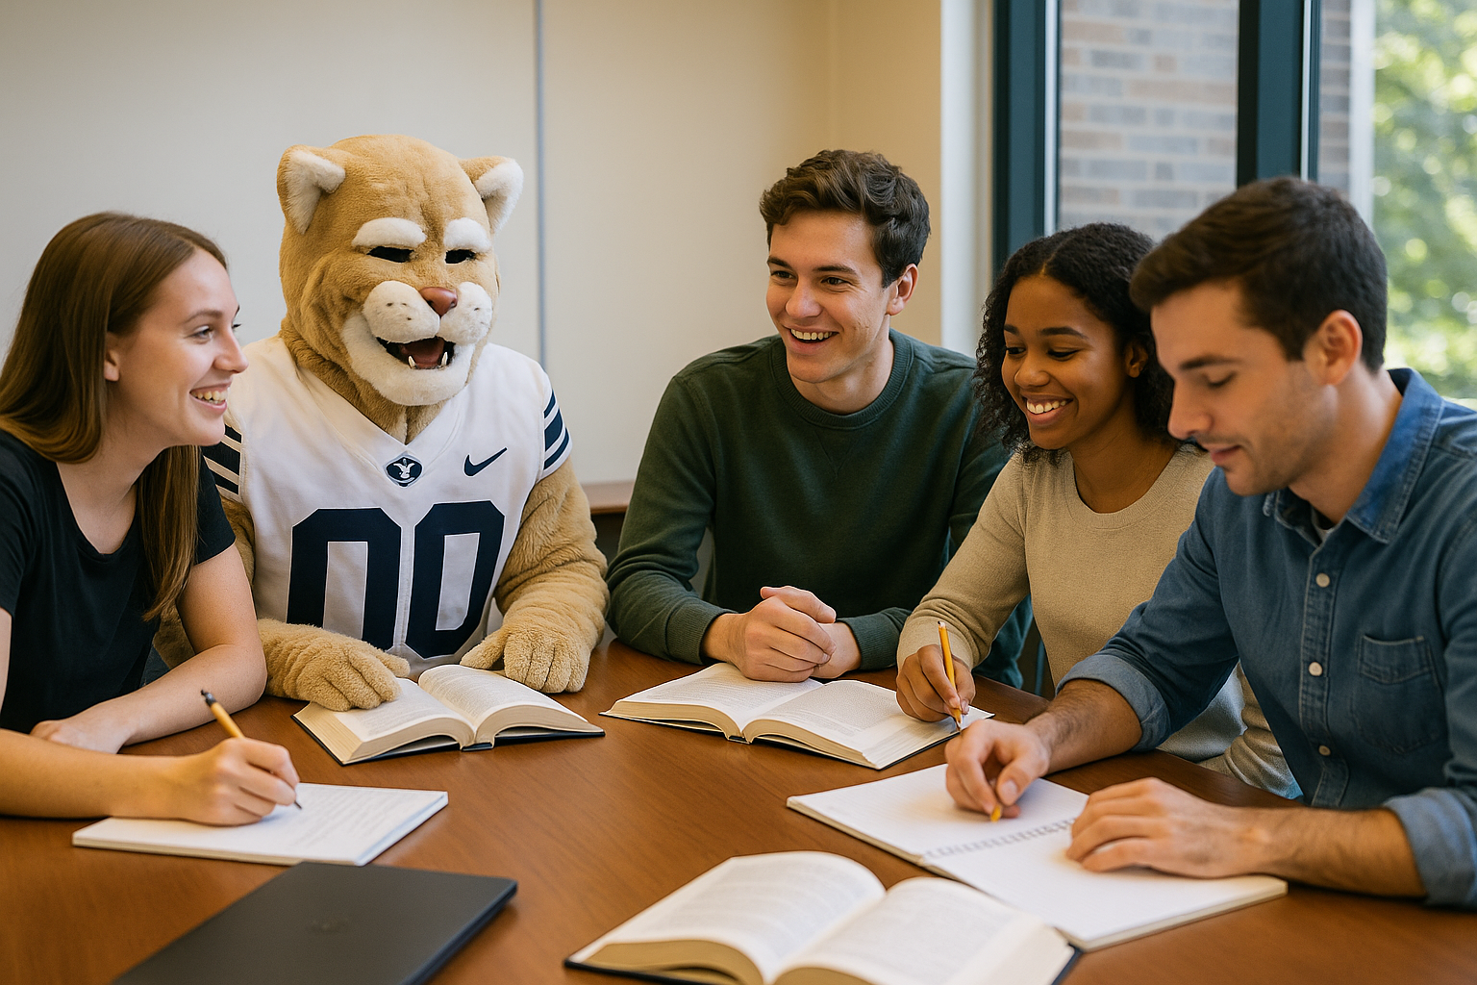
Study Group
She joins the study group. They spread out in the library, sharing snacks and notes. They’re not perfect, but they keep each other going—and it helps her feel a little more prepared.
Early Alert
Notes:
Ice King and Marcelene sitting in a wasteland
Clarence "nature clarence" jpeg

Slide 19
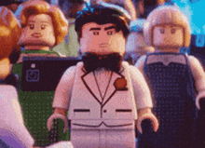
TA Lab
Early Alert
She chooses the TA lab. It’s quieter, and she actually meets a guy who’s studying for the same class. They end up swapping tips and making each other laugh about how confusing the last chapter was.
Notes:
Mordecai and Margaret regular show

Slide 20
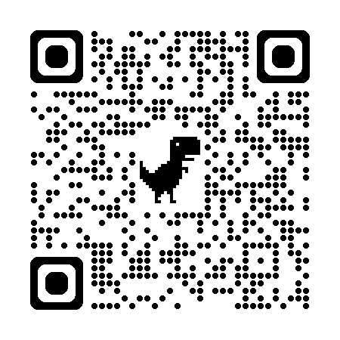
Early Alert
Early Alert is a tool that shows mentors:
How engaged students are in each class
Which classes need improvement
Whether they’re improving—or falling behind
The last time they clicked on Learning Suite for each course
It gives real-time data
More Info
Notes:
We want to really push the message that we as mentors are here to really help each student succeed, and feel empowered!

Slide 21
How Mentors Use Early Alert
They use it to:
Recognize when a student needs support
Start caring conversations (“How are things going? What support would help?”)
Connect students with resources like tutoring, TA labs, office hours
Recognize wins, not just struggles
Continue the Story

Slide 22

Mid-semester, Sarah gets a calling at church as a Sunday School teacher. She’s nervous, but the new role helps her feel like she belongs somewhere on campus. Her ministering sisters and brothers also drop by one night with cookies as an encouraging gift.

Slide 23
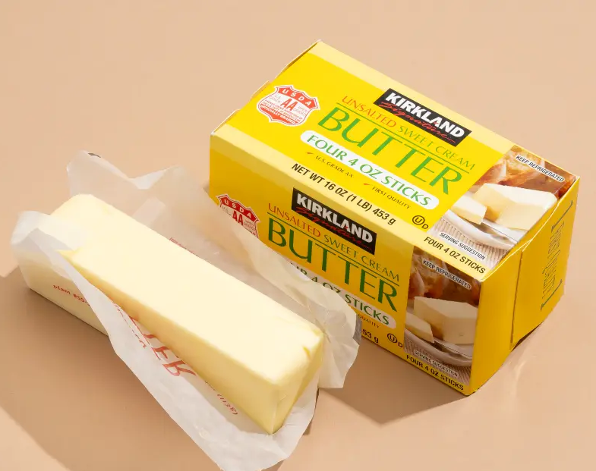

However, soon after, Sarah’s apartment starts to feel cramped. One roommate always leaves dishes in the sink, and the tension is thick enough to cut with a butter knife.

Slide 24

Not knowing if she should approach her roommates, Sarah reaches out to her peer mentor​, and they offer her some good advice.

Slide 25
How can Sarah approach this? Should she go talk to her roommates about the dishes or should she stay quiet try to not let herself get bothered by it?
Choice
Talk it out
Stay quiet

Slide 26

Talk to Them
She chooses to talk. It’s an awkward conversation—her voice trembles a little—but they all agree to work on being more considerate. The apartment starts to feel more like a home, and Sarah’s glad she didn’t keep it all inside.
Why Peer Mentors

Slide 27
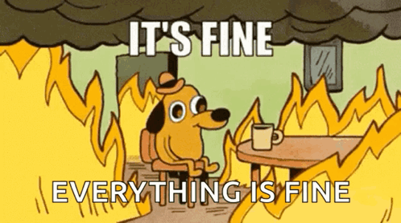
Stay Quiet:
She stays quiet. The tension doesn’t go away, but she learns to carve out her own space, focusing on what she can control. She still wishes she’d spoken up, but she also learns that sometimes it’s okay to let things slide.
Why Peer Mentors

Slide 28
Why Peer Mentors Matter
Peer Mentors aren’t just campus tour guides. They’re trained to help students:
Navigate tough decisions (classes, majors, stress, life)
Stay on track academically and socially
Understand when (and how) to ask for help
Get connected to campus resources that actually work
Feel seen and supported—by someone who’s been there
Get help exploring clubs and campus jobs
Walk through registration and deadlines
And so much more!
Continue the Story

Slide 29

By October, Sarah’s feeling worn down. She’s got two huge projects due in the same week, homesickness that sneaks up in the quiet moments, and that nagging doubt about her major.

Slide 30

She sees everyone else talking about winter registration—but she’s not even sure what she wants to study.

Slide 31

She remembers her mentor telling her there are common experiences throughout the semester—how everyone feels these highs and lows, and it’s okay to not have it all figured out.
Rhythm of the Semester

Slide 32
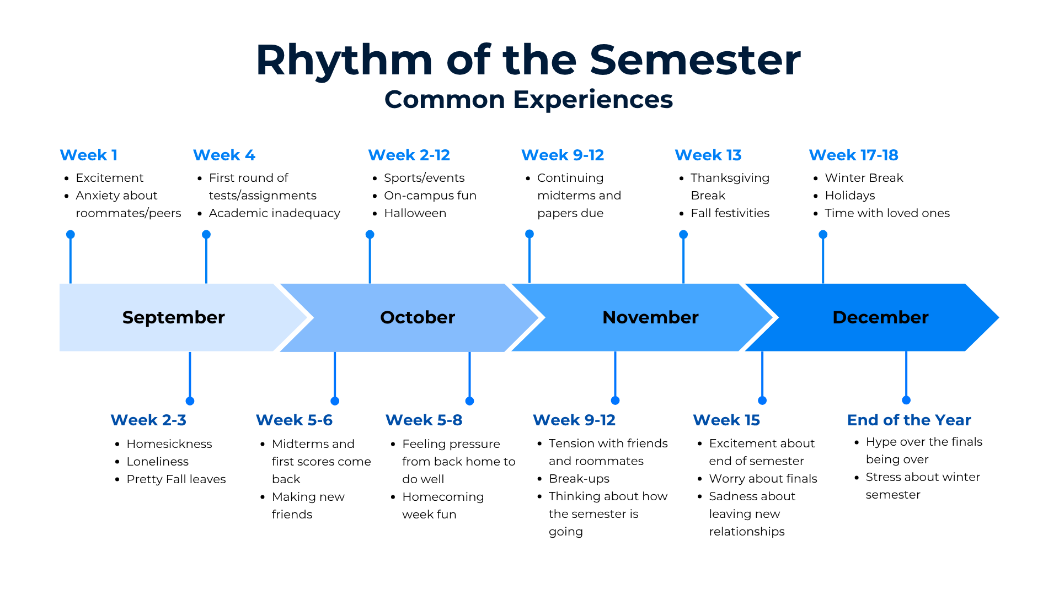
Continue the Story

Slide 33
Should Sarah meet with her mentor and ask for help or push through alone?
Choice
Meet with mentor
Push through alone

Slide 34
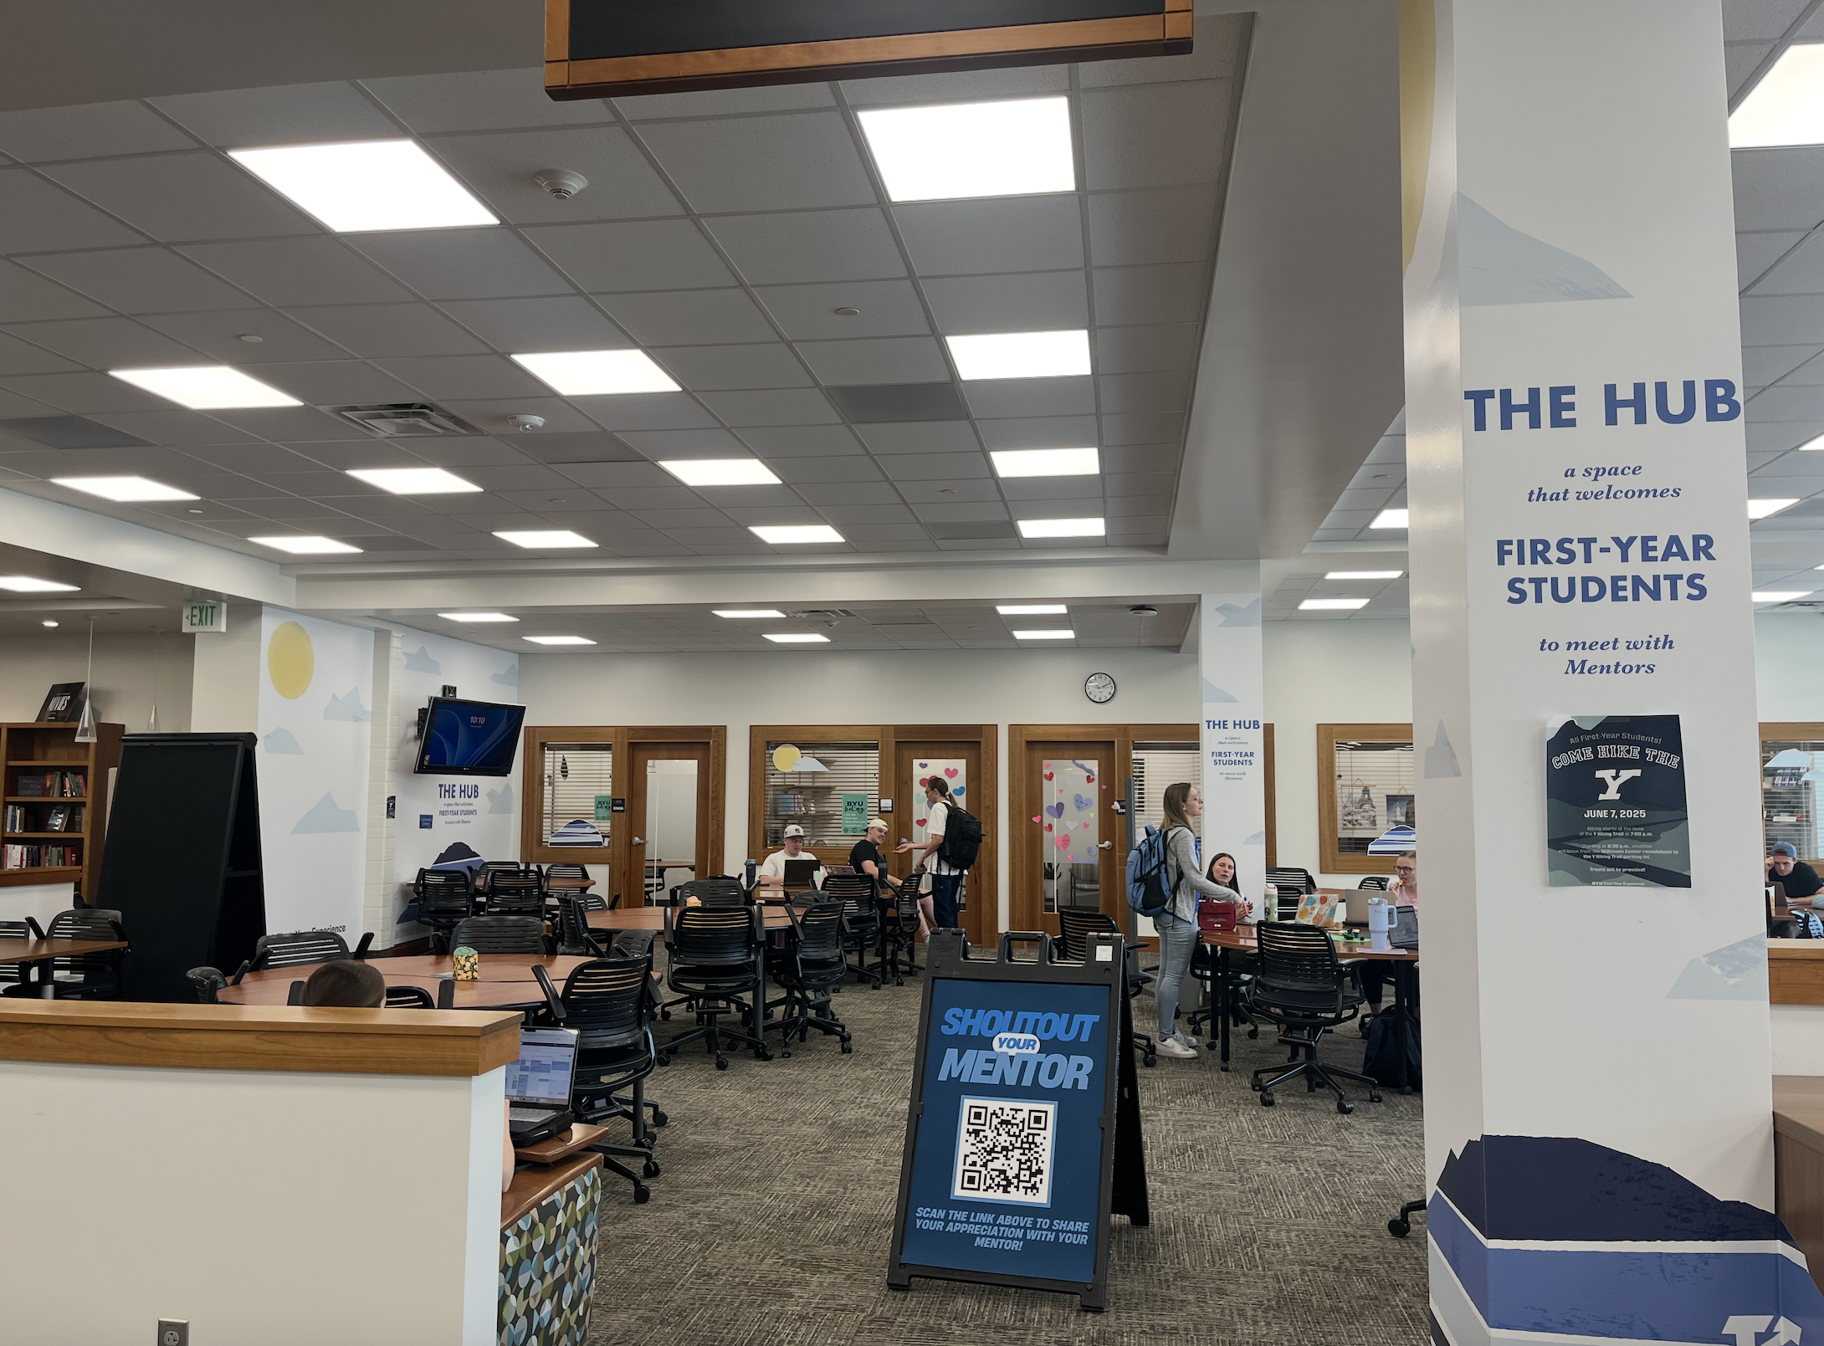
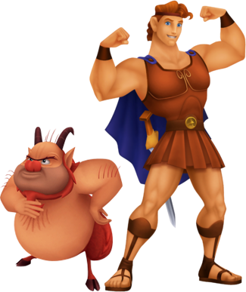
Meet with Mentor
She meets with her mentor in the HUB, the third floor of the library where everything smells like old books and hope. They talk about time management and her fears about registration. Her mentor suggests meeting with an academic advisor, and suddenly she feels like she can breathe again.
Continue the story
Notes:
Maybe a picture of the hub, hercules and phil in hub

Slide 35
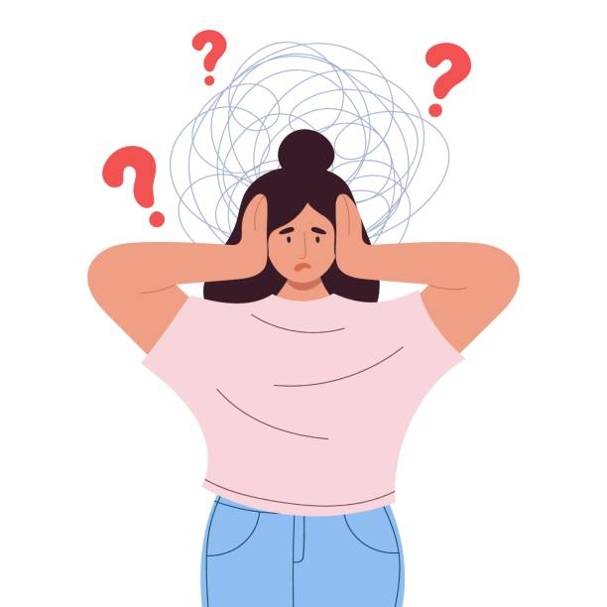
Push Through Alone
She decides to push through alone. She signs up for random classes, following her friend’s schedule just so she won’t feel totally alone. It’s not a disaster, but she still feels a little lost.
Continue the story
Notes:
A person with a confused cloud

Slide 36
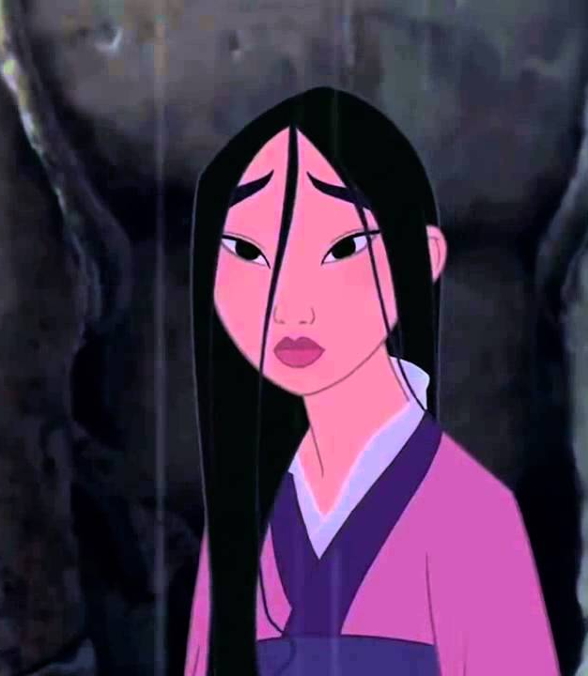
November brings dark clouds and shorter days. Sarah’s feeling the weight of everything, and the breakup with her boyfriend just before Thanksgiving doesn’t help. She knows it's normal to feel a little down, but this feels bigger than her. She reaches out to her peer mentor to ask for some advice.
Notes:
Maybe not a pic since it's a more words?
november meme
Pic of someone texting
Pic of novembeer/changing seasons
Dark clouds and make the scene like mulan

Slide 37
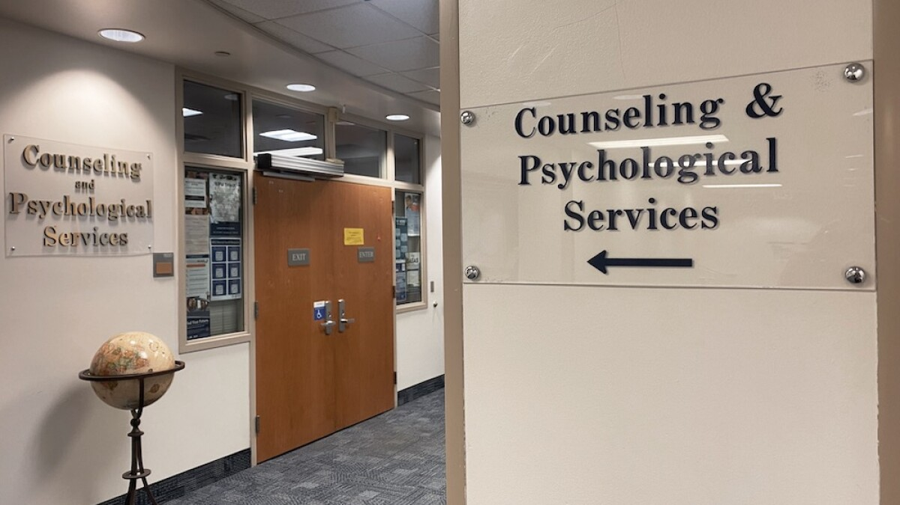
Her mentor tells her about CAPS and Quick Care—places she can go when the blues feel bigger than she can handle. She decides to make an appointment.

Slide 38

That same week, her mom calls just to say she loves her, and her roommate bakes cookies for everyone. It’s small, but it’s enough to remind her she’s not alone. Her roommates also remind her about an upcoming ward activity: a luau with food! But what in the world are Hawaiian haystacks?
Notes:
Cookies meme, cookie monster

Slide 39
Should Sarah go to the ward activity or stay home?
Choice
Ward Activity
Stay home

Slide 40
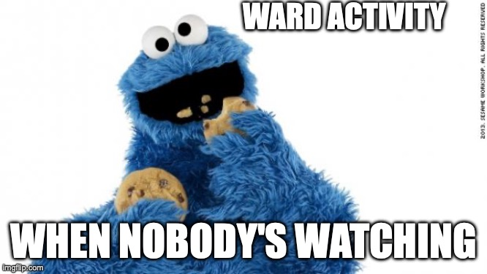
Go to Activity
She decides to go to the ward activity. It’s a night of games and free food—just what she needed. She laughs, eats too much, and feels like herself again.
Continue the story
Notes:
People laughing

Slide 41


Stay Home
She decides to stay in and tackle homework. She feels a little better being ahead, but she also realizes how much she misses just being with people.
Continue the story
Notes:
Pic of someone doing homework

Slide 42

Finals come fast. Sarah finds herself up late studying and hoping for the best. She’s not sure she’s ready for one final in particular—she is not feeling confident about it at all.
Notes:
Finals meme

Slide 43
Sarah's mentor asks if they can meet one last time this semester. In their meeting, her mentor shares tips for getting through her first year.

Slide 44

Finals end and Sarah walks out of the Testing Center with a deep breath and a quiet smile. She’s proud of how far she’s come—every choice, every stumble, every small win.
Notes:
Rocky

Slide 45

She thinks back to that first day when she was lost in the JSB, feeling like she didn’t belong. Now she knows she does.
Notes:
Cartoon characters (disney) hugging, think tangled meeting her family or moana

Slide 46

She’s learned how to ask for help, how to be a friend, and how to care for herself—even on the days when it felt impossible.
Notes:
Picture: A "feeling of accomplishment" Silhouette

Slide 47
Just like Sarah every choice you make will shape your journey.
“How will you prepare for your first year?”

Slide 48
Any questions about heading into your first semester?

Slide 49
My BYU Journey Activity
Notes:
Allie starts

Slide 50
Jalen Martinez Jalen is halfway through his first semester at BYU. He’s been going to class and wants to do well, but he’s starting to fall behind—especially in WRTG 150, where he hasn’t turned in the last two assignments. He hasn’t checked Learning Suite in a few days and hasn’t responded to texts from his mentor. It seems like he might be feeling stuck or overwhelmed, but with the right support, he could easily get back on track. What should Jalen do next?

Slide 51
Check-in with Mentor Appointment with Professor to go over assignments Appointment with Writing Center tutor Opening LearningSuite and prioritizing one task Connecting with CAPS or academic advising
Possible Solutions:
Notes:
=

Slide 52
Liz Chang Liz is taking on a lot—17 credits, three clubs, and she was just offered a position as a TA. She’s excited about her opportunities and wants to do everything well, but she’s also feeling stretched thin. She missed an assignment after not checking Learning Suite for a week and is starting to feel a little overwhelmed. Liz says she’s “totally fine,” but might benefit from learning how to balance all the good things she’s involved in. What should Liz do next?

Slide 53
Help from mentor reassessing her workload and prioritizing Talk with professors or TA's Help from mentor about time management strategies Remembering she doesn't have to do it all alone.
Possible Solutions:
Notes:
=

Slide 54
Mateo Johnson ​ Mateo is going to class consistently, but recently told his mentor he’s wondering if BYU is the right fit for him. He hasn’t found close friends yet and hasn’t gotten involved outside of classes. While he’s unsure about what to do next, Mateo is trying to figure things out and is open to ideas. He wants to feel more connected.
What should Mateo do next?

Slide 55
Explore campus communities or clubs Intramural sports Attending an event with a mentor or friend to ease the pressure Get involved with BYUSA Office of Belonging
Possible Solutions:
Notes:
=

Slide 56
Allison Smith ​ Allison is starting to realize that her major might not be the right fit. She’s nervous about changing directions—especially because her parents were excited about her current path—but she’s also curious about what else she could study. She doesn’t want to fall behind on graduation, but she’s starting to explore her options and think about what she really wants. ​ What should Allison do next?

Slide 57
Meet with academic advisor to talk through what changing majors might mean for her timeline Career exploration tools like a visit to Exploration Point Talk to someone in a major she's curious about Meet with her mentor Trying out an elective
Possible Solutions:
Notes:
=

Slide 58
Any questions about navigating your transition to college?

Slide 59

Tools to start your First Year!

Slide 60

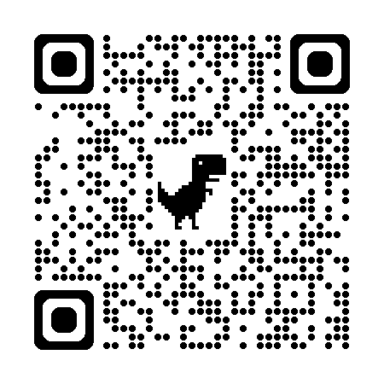
Wi-Fi
Username: [netID]@byu.edu
Password: [your BYU Password]

Slide 61
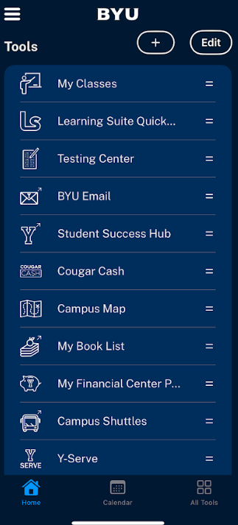
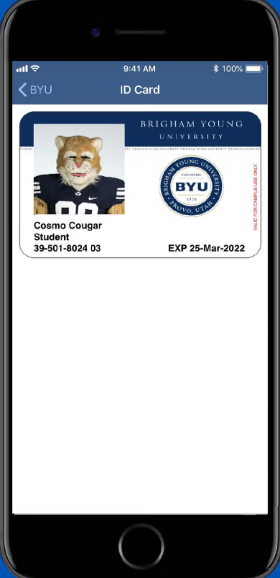
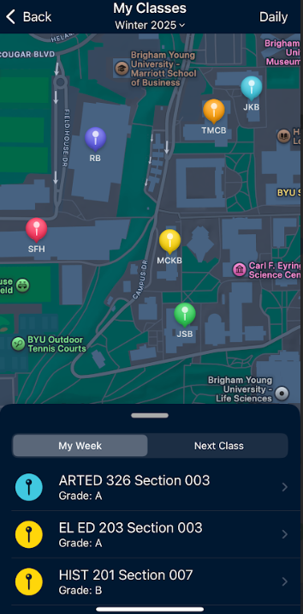
BYU App

Slide 62
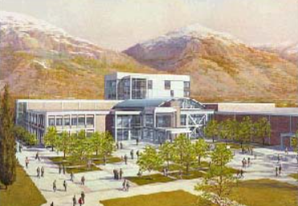
Student Service Centers in the Wilk
Counseling and Psychological Services (WSC 1500)
Title IX (WSC 1320)
ID Center (WSC 1057)
University Advisement Center (WSC 2500)
Multicultural Student Center (WSC 2400)
Accessibility Center (WSC 2170)
Enrollment Services (WSC 3326)

Slide 63
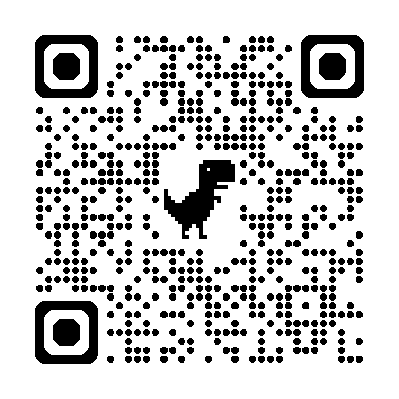
Questions
Schedule a meeting with me

Slide 64
Head outside

